Slide 1




Classifying Student Engagement with Multimodal Data:
A Deep Learning Approach
Enhancing Student Learning with AI-Powered Engagement Analysis
Student Name :--------------------

Slide 2


Team Members Page
Elaborate on what you want to discuss.
Name
Name
Name
Name
Title or Position
Title or Position
Title or Position
Title or Position

Slide 3


Welcome To Presentation
I am ----------- , This presentation will explore innovative ideas and concepts within the field of Machine Learning. Let us begin.

Slide 4

The Challenge: Identifying Engagement Gaps in the Classroom
Traditional methods rely on subjective observations.
It's difficult to catch quietly disengaged students.
Current measures often lack real-time insight.
There is a need for a more robust solution

Slide 5


Our Approach: A Roadmap to Understanding Student Engagement
The Problem
The Solution
Our Findings
Conclusion
Why traditional methods are not enough.
Using multimodal data for better insights.
The performance of our model.
Main takeaways and a call to action.

Slide 6

A New Way to See Your Students: The Power of Multimodal Data
Data Sources
Facial Expressions
This model combines multiple sources of data to paint a more complete picture of student engagement.
Facial expressions reveal emotional cues that may be missed through observation alone.
Speech
Heart rate
Speech provides insight into cognitive processes and the affect of a student.
Heart rate offers insights into a student's physiological arousal levels.

Slide 7
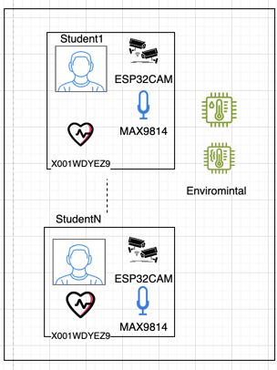
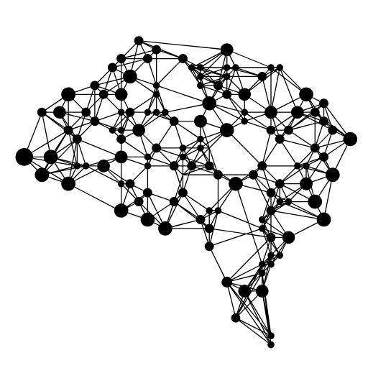

How AI Works: Turning Data into Engagement Insights
Data Collection: Student data is captured from multiple sources (facial expressions, speech, heart rate). | Model Training: Machine learning models analyze the data to identify patterns linked to different engagement levels. | Engagement Insights: The model identifies the student's engagement, allowing educators to access this data.

Slide 8
How the Model was Developed: A Simplified View
Data Input
Data cleaning.
Class imbalance fixing.
Core Models
Random Forest
Support Vector Machines
Performance Evaluation
Feature Engineering.
Neural Networks
Accuracy
Precision
Recall
F1-Score
Confusion Matrix

Slide 9
How the Model was Developed: A Simplified View
Our approach utilizes machine learning to analyze student data and identify patterns associated with different engagement levels.
We explored several machine learning algorithms, including Random Forest, Support Vector Machines, and Neural Networks, to determine the best approach.
We combined multiple sources of data—facial expressions, speech patterns, heart rate and an 'Overall Confidence Score'—to ensure a holistic view of student engagement.
We used an ensemble method that combines the best features of multiple models to achieve the most reliable and accurate results.
The model was trained using a combination of existing data, which was validated by the model.

Slide 10
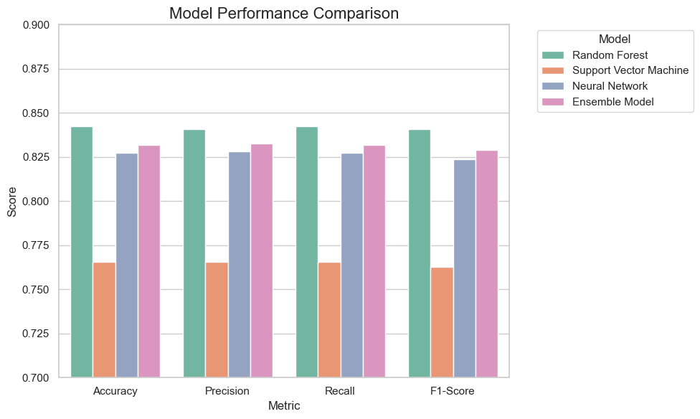
Model Performance:
The Results: Random Forest Model Achieves Top Performance
We evaluated several models, including Random Forest, Support Vector Machines, and Neural Networks, to identify the most effective approach.
Our Random Forest model achieved the highest accuracy of 84.23 % , outperforming the other tested models.
This significant accuracy demonstrates the potential of using machine learning to accurately detect student engagement in classrooms

Slide 11
Practical Applications: How To Use These Insights
Identify students who may be quietly disengaging during lessons in real-time, allowing for timely interventions.
Use the data to adjust teaching strategies and lesson plans to better meet the needs of all students.
Provide a more personalized approach, focusing on students that may need additional support to achieve better learning outcomes
Gain an objective, data-driven understanding of how different lessons impact student engagement
Elaborate on the featured statistic.

Slide 12
Limitations & Future Development: Building on Our Findings
Our study was conducted using a relatively small dataset, with opportunities to include a larger and more diverse student population in future research.
While the Random Forest model performed well, Future work should plan to explore the use of more advanced machine learning models, as well as how to incorporate additional data sources.
Future work will focus on testing and refining the model in real-world classroom environments to ensure its scalability and effectiveness.
Elaborate on the featured statistic.

Slide 13

Thank you!

